Slide 1

Design Patterns
LESSON 2
sTRUCTURAL PATTERNS

Slide 2
Classification
Creational patterns provide various object creation mechanisms, which increase flexibility and reuse of existing code.
Singleton, Factory Method, Abstract Factory, Builder, Prototype
Structural patterns explain how to assemble objects and classes into larger structures while keeping these structures flexible and efficient.
Adapter, Bridge, Composite, Decorator, Façade, Flyweight, Proxy
Behavioral patterns handle how objects interact: communication, dependencies, isolation.
Chain of responsibility, Command, Iterator, Mediator, Memento, Observer, State, Strategy, Template Method, Visitor
Creational Patterns
Structural Patterns
Behavioral Patterns
Notes:
Creational = mecanisme de creare a obiectele pentru a oferi flexibilitate si reutilizare a codului
Structural = asamblarea obiectelor si a claselor, integrarea lor structuri mai largi, lasand totusi flexibilitate. Aici o sa fie mai grele exemplele, pentru ca nu o sa lucram pe structuri largi
Behavioral = se refera mai mult la algoritmi si asignarea responsabilitatilor intre obiecte

Slide 3
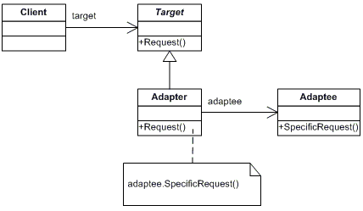
Adapter
Problem: interface incompatibility, legacy code, 3rd party apps that do not fit your interface
Solution: create adapter that makes the conversion between 2 incompatible classes. Target uses a method from Adapter and the Adapter translates that request so that the Adaptee (which is a private field in Adapter) will understand

Slide 4
Adapter in a few words + examples from open-source projects
Identify the 3 actors: Client, Adapter, Adaptee
The adapter does not add functionality! It only allow unrelated classes to work together.
Usually, it is created during the process, because it provides a different interface to a code, that was not originally intended.
When to use it: data from multiple data sources, work with multiple different systems or integrate legacy code in your app
Java: java.util.Collections
C#: System.IO.StreamReader
Backward compatibility with COM objects
https://docs.microsoft.com/en-us/archive/msdn-magazine/2005/july/discovering-the-design-patterns-you-re-already-using-in-net
jQuery: jQuery.fn.css()

Slide 5
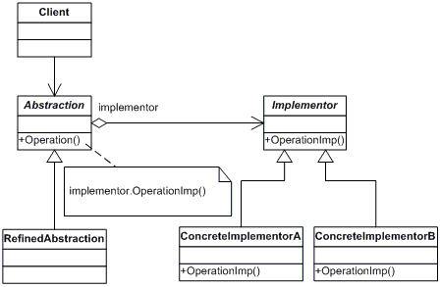
Bridge
Problem: a lot of subclasses because the objects are composed (red car with diesel engine, blue car with petrol engine, etc.)
Solution: composition. Add field of type B (Implementor) in class A (Abstraction), that will act as a bridge

Slide 6
Bridge in a few words + examples from open-source projects
Identify it by composition
Two pieces that you need to work together, but be independent from one another
Use it when you need different versions of the same system or product,
In contrast to Adapter, you use Bridge upfront, when you start designing. They are similar, but with different intentions
https://www.codeproject.com/Articles/890/Bridge-Pattern-Bridging-the-gap-between-Interface
https://web.mit.edu/java_v1.5.0_22/distrib/share/docs/guide/jdbc/bridge.html

Slide 7
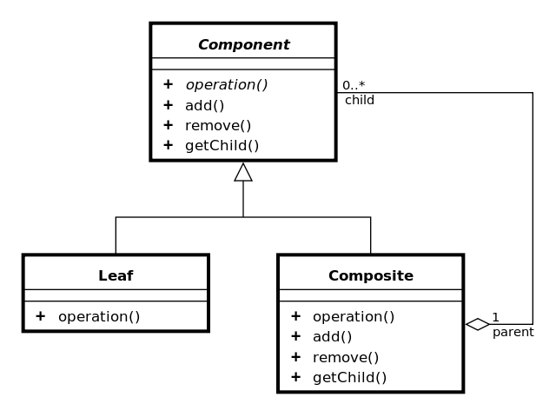
Composite
Problem: complex tree representation of your app
Solution: In Client, work only with an interface implemented by leaves and composites.
Have one common method (render, computePrice etc.), Leaf does some work for itself, Composite deals with itself + delegate work to its children

Slide 8
Composite in a few words + examples from open-source projects
Works only with a tree structure (hierarchy)
Deal with any object in the same way, regardless it’s a complex or simple object
3 actors: Root (=Component), Composite, Leaf
Composite !== Composition
Example usages in apps: file system, task tracker,
Java: java.awt.Container
C#: System.ComponentModel.IComponent
jQuery: addClass()
React architecture (render method, App as entry point)
VueJS

